Slide 1
Smarter Delivery Planning: Optimizing Routes, Reducing Cost, and Improving Reliability
Presenter: Farnaz Farzadnia

Slide 2
The Business Challenge
The company delivers materials to multiple factories nationwide.
Orders differ by size, weight, and delivery deadlines.
We have a limited number of trucks, each with different capacities.
Possible Impact of lacking optimization model:
Some trucks are overloaded while others underused.
Late deliveries cause production delays.
We spend more on transport than necessary.

Slide 3
The Proposed Solution
The proposed model is an intelligent planning system that uses mathematical optimization to automatically find the most cost-effective and feasible delivery plan.

Slide 4
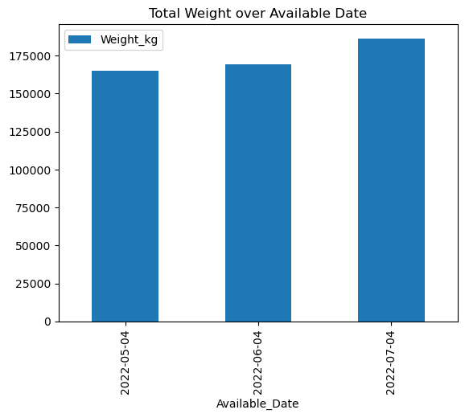
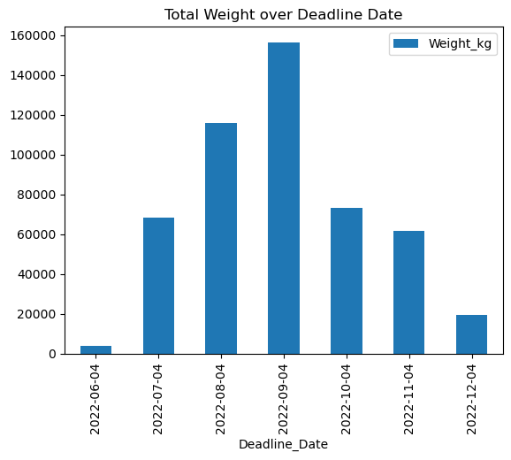
Look at Data

Slide 5
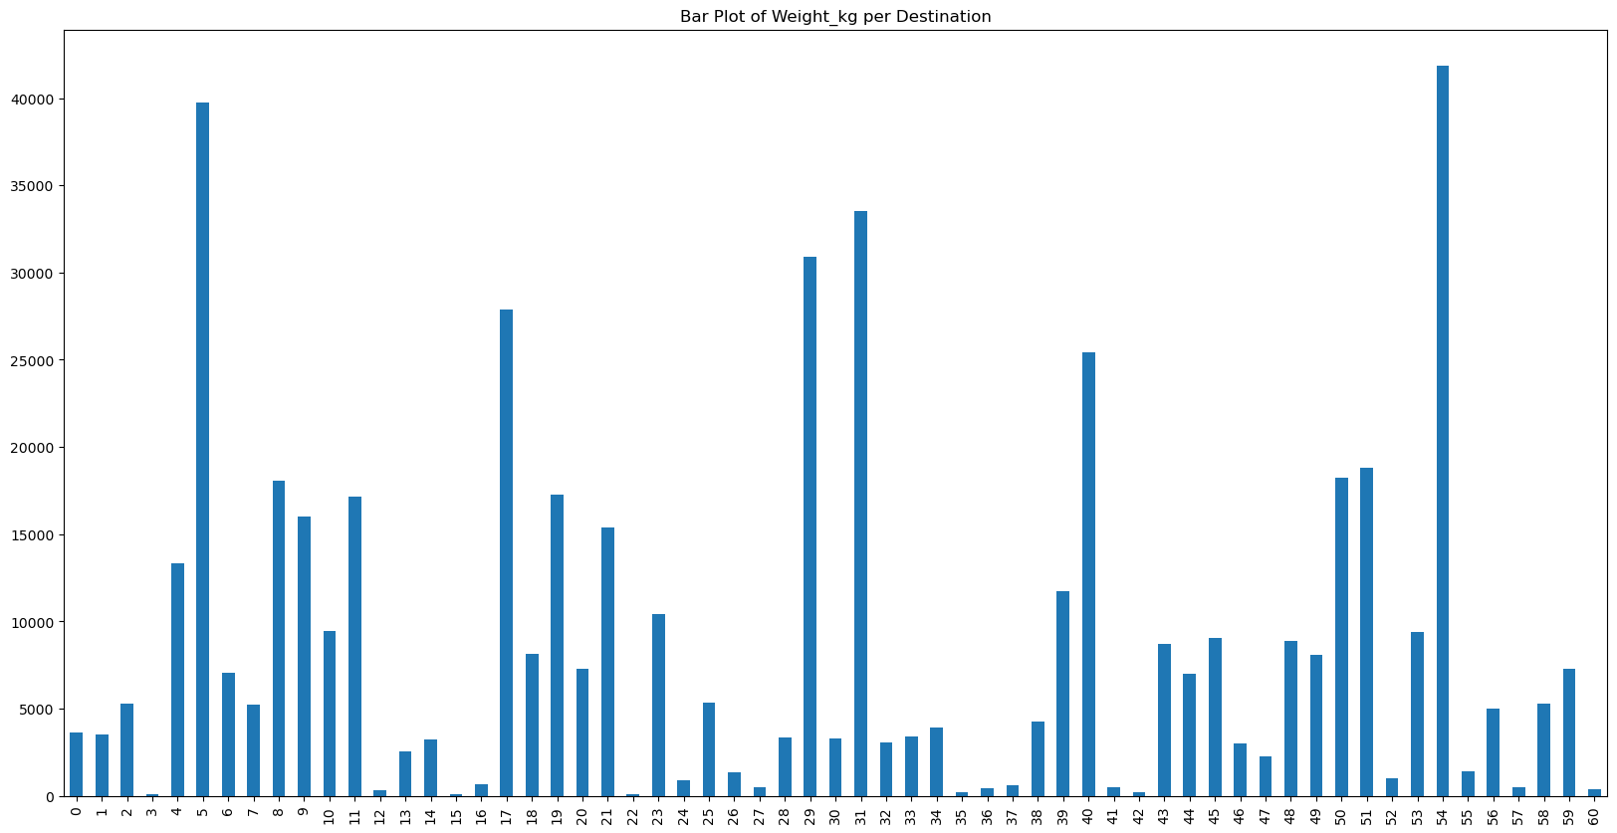
Distribution of loads per destination
The x-axis is destination and y-axis is the total load(kg)

Slide 6
How the Solution Works
Stage 1: Delivery schedule
Decides which delivery item go on which day.
Respects availability and deadlines.
Stage 2: Routing Optimization for Each Day
Objective: Balances truck loads across time horizon.
Objective: Minimizes travel cost, and handling costs.
Output: The best sequence of stops for each truck.
Decides which truck go on visit which factory for delivery.
Output: List of deliver items and available trucks in each day

Slide 7
What Makes It Smart?
Capacity and size-aware: Never overloads trucks.
Time-sensitive: Only picks items when they’re ready.
Flexible: One customer can be visited more than once in different days if needed.
Balanced: Keeps daily truck loads even.
Reliable: It is adapted to unforeseen incidents.
Adaptable: Easily add on-day delivery, time window delivery

Slide 8
How It Would be Used?
Process:
Input daily/weekly order data into the system (Excel or ERP integration).
Optimization engine runs automatically (e.g., powered by Gurobi).
Output: delivery schedule + truck routes.
Dispatch team reviews and approves.
Routes shared with drivers via mobile or printed manifest.
Deployment Option:
Cloud-based dashboard or internal planning tool.

Slide 9
Responsible and Fair Use
The system supports human planners; it doesn’t replace them.
Final decisions remain with the logistics manager.
Includes safeguards to respect:
Truck driver rest and work limits.
Delivery time windows.
Operational constraints (capacity, stop limits).
Regularly monitored to ensure fairness and reliability.

Slide 10
Deployment Roadmap
Phase | Description | Duration
1. Pilot | One region, 3 trucks | 1 month
2. Feedback & tuning | Adjust parameters, verify performance | 1 month
3. Rollout | Expand to all factories | 2–3 months
4. Integration | Connect to ERP or order system | Continuous

Slide 11
Potential Extensions
Scheduling of drivers.
CO₂ reporting per route.
Dynamic delivery services.
Smooth dispatching trucks on the time horizon.
Consider Warehouse holding cost.
More advanced routing, like having a hub and spoke network.

Slide 12
Closing
“This optimization solution transforms how we plan deliveries, by making them faster, cheaper, and greener, while empowering our teams with intelligent tools.”

Slide 13
Technical Flowchart
1. Assigning items to a truck in a delivery time horizon
Availability of truck
Truck size
Truck capacity
Max number of stops
2. Consolidate delivery items of one destination for a given day
3. Capacitated vehicle routing problem for each day
Max number of stops
Using all trucks
Capacity and size check

Slide 14
Questions
How to handle data accuracy?
Who are stack holders?
How to provide trust?
When to say that pilot phase is over?
How to provide reliability?
How the unpredictable events are handled?
Do we have another system for dynamic adjustments?

